Slide 1

DriverPass System Analysis
Nate Dukes
Notes:
[No speaker notes required for this slide.]

Slide 2

System Requirements
Students will be able to login and view their study material
Students will be able to schedule meetups with their instructor
Users will be able to login through an online web application to access the site
An offline database for storing the user information
Notes:
The students for DrivePass need to be able to login to the website, view their material, study it, practice it, and if needed, meet with their instructor. This defines the basic use of the service; on the back end, their information is stored in a database, connected to the internet for management by the system administrators.

Slide 3
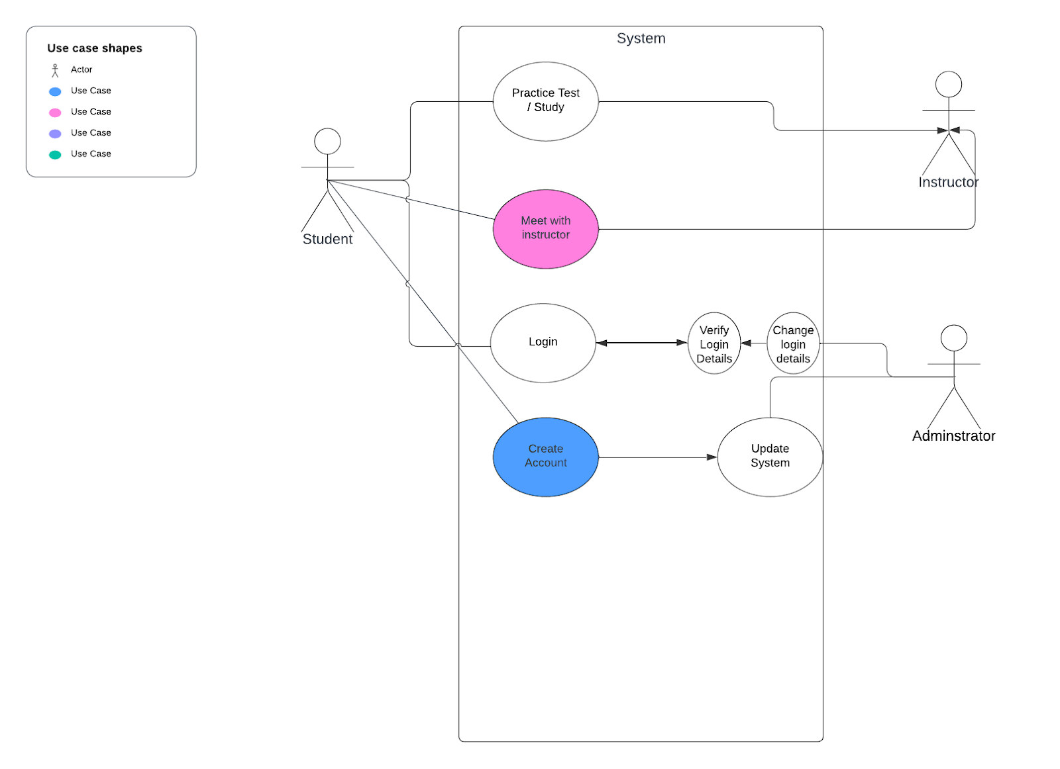
Use Case Diagram
[Insert your use case diagram here.]
Notes:
There are three basic entities involved in this system- all stemming from a basic “user.” The student, the instructor, and the administrator. The student can interact with the website on their own to practice or take tests and study, or they can interact with the instructor to meet up and talk about their problems, and if it’s not working out, contact the admin and either get a new instructor, stop the service, or manage other security concerns like password changes.

Slide 4
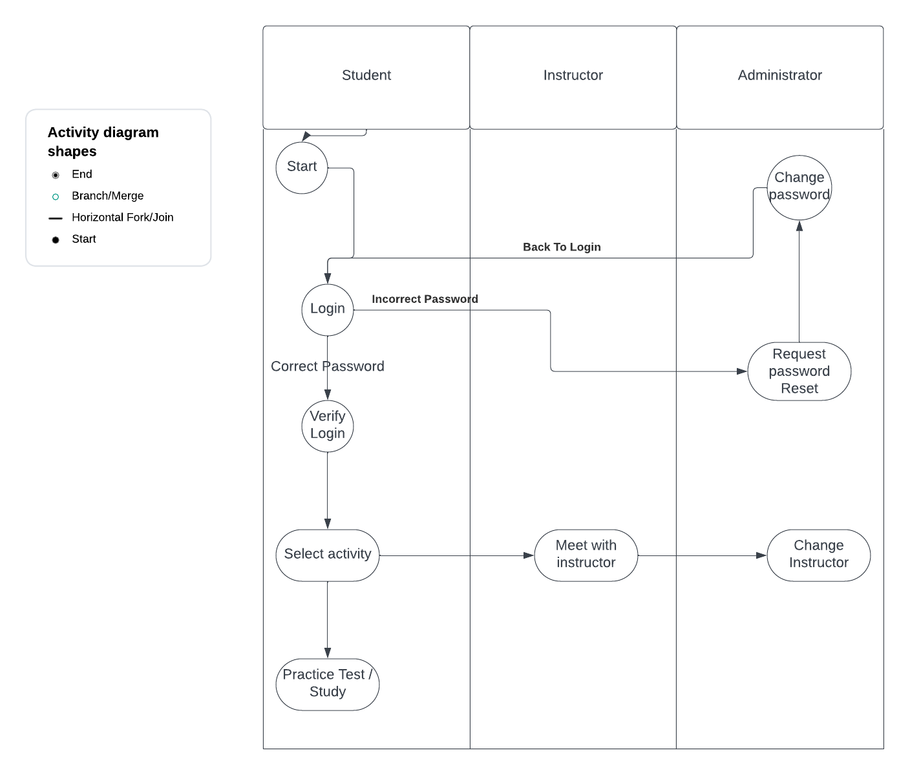
Activity Diagram
Notes:
This activity diagram repesents the flow a given user might take for logging in and resetting their password. It also shows how they might access an instructor meet up or test, how they can request another instructor, change their password, and where the security steps show up. Login, verify, update information, choose activities, complete activities.

Slide 5
Security
User information stored in an offline database
Encrypted user information
Administrators can update and revoke privileges at will
Automatic lockouts
Notes:
The system is very secure, in that within the current scope of the project, there are not that many places where security can be exploited. There is important financial and personal information, but it is all stored offline on a database, hidden away from instructors and admins unless explicity needed for a reset, as an example.

Slide 6
System Limitations
Users might not always have perfect internet access
Updating the website as new laws are made / changed could be difficult
The scope of the project is unknown
Notes:
This system relies strongly on users having strong internet access; without it they can not access the site. Although they could download the material for study, or even have automated tests, they will not have the option to meet with their instructor or access their account through the database without a connection to the site first. Beyond this, the scope of the project is not clearly known- as updates roll out there could be need for more complex system architecture, among other things.

